Slide 1
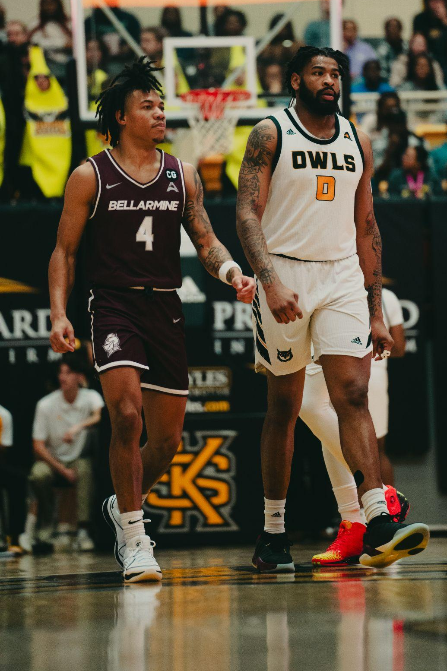
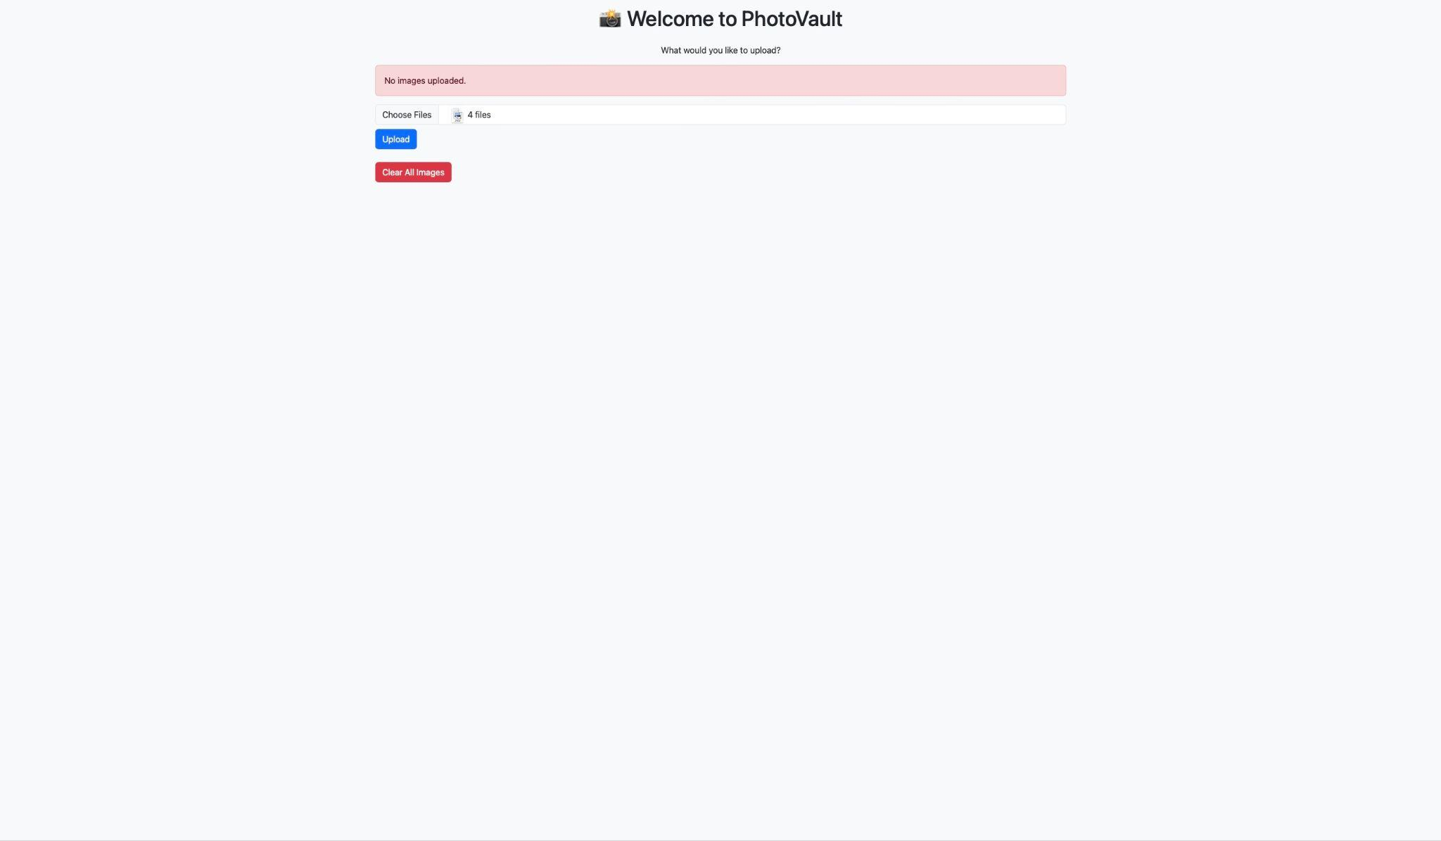
PhotoVault
An easy and efficient way to upload some of your best images!
-Photo Gallery Uploader -
Emmanuel Agyeman

